Slide 1
Fatty Acid Oxidation

Slide 2
Objectives
Explain how mobilization of FA occurs from adipose tissue
Describe the transport mechanism of long chain fatty acids into the mitochondrial matrix
Outline the reactions in β oxidation
Explain how oxidation of odd chain fatty acids differs from that of even chain FA
Outline the mechanisms involved in oxidation of unsaturated fatty acids

Slide 3
Fatty Acid (FA)
Fatty acids stored as TAG in Adipose tissue
Provide metabolic energy through oxidation
Complete oxidation of fatty acids to CO₂ and H₂O yields 9 kcal/g fat
Fatty acid oxidation occurs in mitochondria
Red blood cells cannot use FA as fuel

Slide 4
Steps in fatty acid oxidation
Release of fatty acids from TG in adipose tissue
Transport of FA to target tissues
Activation of FA within cells
Entering of FA into mitochondria
Oxidation of fatty acids via β oxidation and TCA cycle
Production of ATP through ETC and oxidative phsphorylation

Slide 5
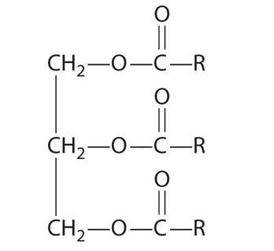
Release of FA from TAG in adipocytes
Initiated by hydrolytic release of fatty acids from
triacylglycerol by hormone sensitive lipase
R3

Slide 6
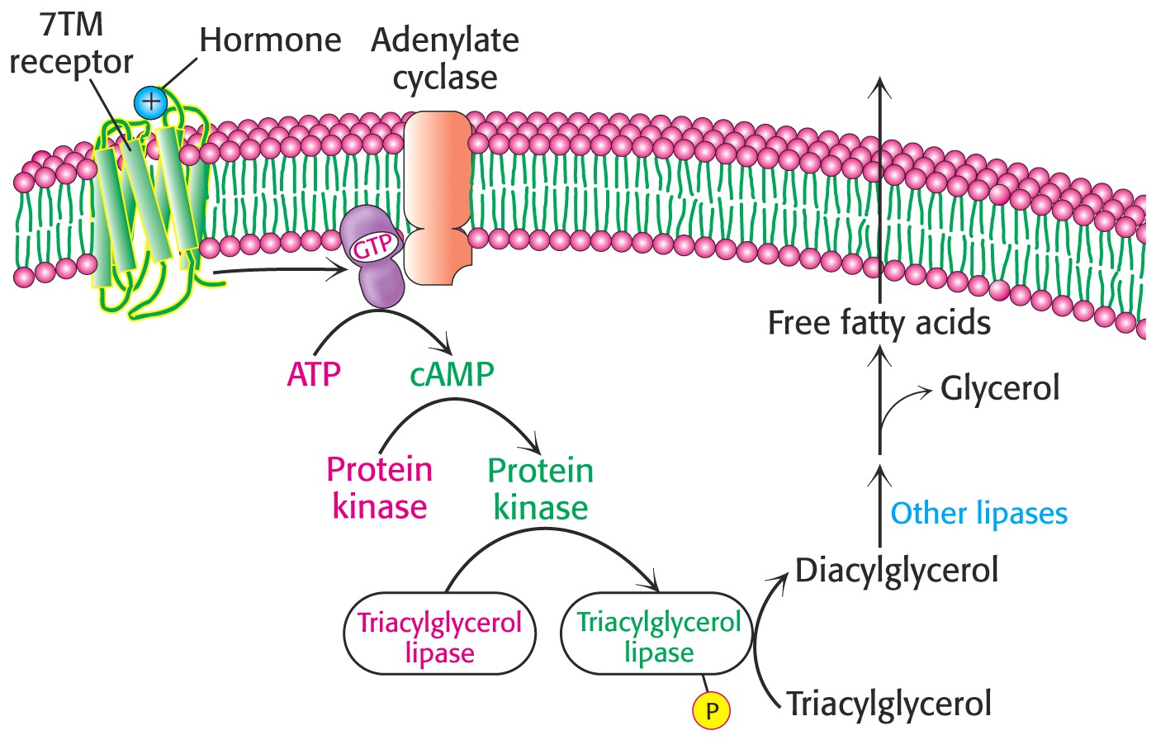
Release of fatty acids cont….
Epinephrine or Glucagon
Target tissues - skeletal muscle, cardiac muscle, adrenal cortex etc.
Liver

Slide 7
Fates of Glycerol
Glycerol
Glycerol-circulates freely
Glycerol -3-P
Liver
Dihydroxy acetone-P
Glycolysis
Glycerol enters into circulation and transport to liver
In Liver glycerol oxidized through glycolysis

Slide 8
Fate of Fatty Acids
FA transports to Target tissues - skeletal muscle, cardiac muscle, adrenal cortex etc. as bound to albumin in circulation
After enter into cells, activation of Fatty acids occurs by thiokinase/Acyl CoA Synthetase in the cytosol before entering into mitochondria
thiokinase
Fatty acids
+
Co A + ATP
Fatty acyl CoA + AMP + PP_{i}
pyrophoshatase
PP_{i} 2Pi

Slide 9
Entering of Activated fatty acids mitochondria
Short chain fatty acids are carried directly into the mitochondrial matrix
Long-chain fatty acids cannot be directly transported into the matrix
Long-chain FAs are converted to acyl carnitines for transport

Slide 10
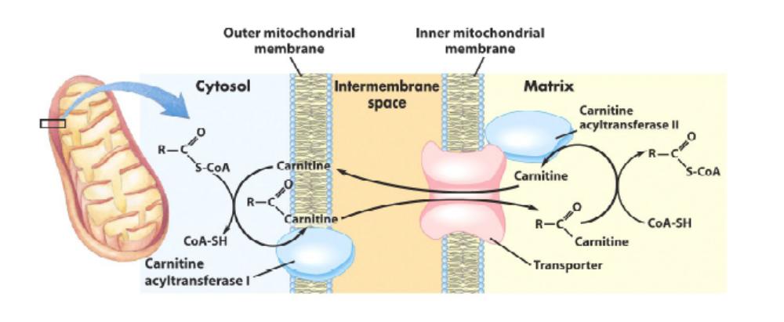
Carnitine as a Carrier
Carnitine carries fatty acyl groups across the inner mitochondrial membrane
Transport system
Carnitine shuttle
Acyl Carrier
Carnitine
CAT I
CAT II
Notes:
7

Slide 11
Carnitine Shuttle
Carnitine Acyl transferase I (CAT I), an enzyme on the outer mitochondrial membrane, transfers a fatty acid from CoA to the carnitine.
2. An antiporter (translocase) in the inner mitochondrial membrane mediates exchange of carnitine for acylcarnitine.
3. Carnitine Acyl Transferase II (CAT II), an enzyme on the inner mitochondrial membane, transfers the fatty acid from carnitine to CoA.
4 Fatty acyl-CoA is now in the matrix

Slide 12
Inhibitors of the carnitine shuttle
Malonyl coA (building block of fatty acids) inhibits CAT 1 and inhibits entry of acyl groups in to mitochondria
Fatty acid synthesis & breakdown is reciprocally regulated.

Slide 13
Genetic defects in the Carnitine Shuttle
Congenital absence of CAT in skeletal muscle,
or reduce concentration of carnitine due to defective synthesis.
Result in inability to use long chain FA as a metabolic fuel causes myoglobinaemia and weakness following exercise

Slide 14
Mitochondrial β Oxidation of FA
2C fragments are removed as Acetyl CoA from the carboxyl end of the Fatty acyl CoA molecule
Consist of 4 reactions and result in the shortening of the fatty acid chain by 2C
Step 1. Oxidation FADH2
Step 2. Hydration
Step 3. Oxidation NADH
Step 4. Thiolytic cleavage Acetyl co A

Slide 15
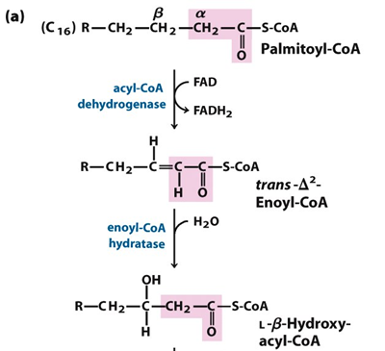

Slide 16
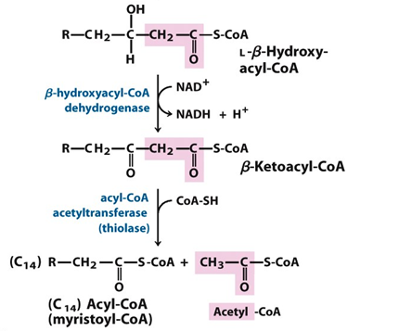

Slide 17
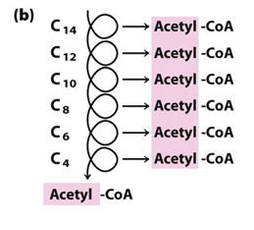
β Oxidation Pathway
The β oxidation pathway is cyclic. The product, 2 C shorter, is the input to another round of the pathway.
If the fatty acid contains an even number of C atoms, the final reaction cycle yields 2 copies of acetyl CoA.

Slide 18
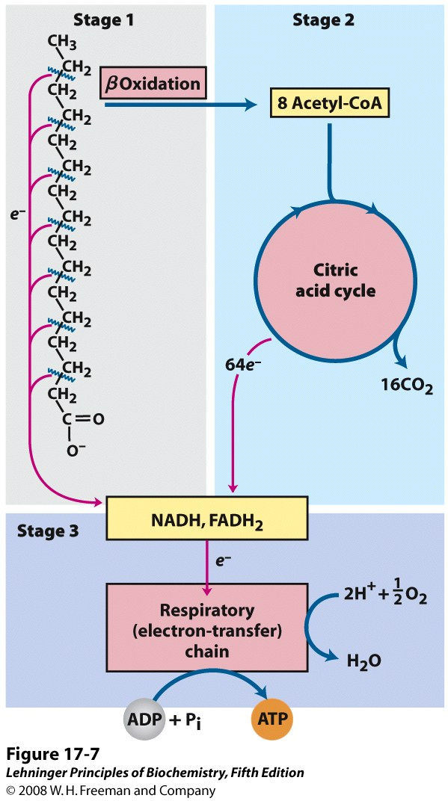
Three stages
Fatty acids undergo oxidative removal of successive two-carbon units in the form of acetyl –CoA, starting from the carboxyl end of the fatty acyl chain
Aceyl-CoA are oxidized to CO2 in the citric acid cycle
Electrons from first and second stage are transferred to ETS chain, passing to oxygen with the formation of ATP.

Slide 19
Summary of one round of the β -oxidation pathway
Fatty acyl-CoA + FAD + NAD⁺ + HS-CoA
Fatty acyl-CoA + FADH₂ + NADH + H⁺ + acetyl-CoA
(2 C less)

Slide 20
ATP yield from oxidation of palmitic acid in to 8 acetyl coA
7 NADH provide ATP 7×3 = 21
7 FADH2 provide ATP 7 ×2 = 14
8 acetyl CoA provide ATP 8 x 12 = 96
Total yield = 131
For activation = -2
Net yield = 129

Slide 21
Oxidation of Odd Chain Fatty Acids
For a fatty acid with an odd number of carbons, the final round of β -oxidation yields acetyl-CoA & propionyl-CoA.
Propionyl-CoA is converted to the Krebs cycle intermediate succinyl-CoA, by a pathway involving vitamin B_{12.}

Slide 22
Oxidation of odd chained FA
Propionyl CoA
Propionyl CoA carboxylase (biotin)
CO₂
Methyl malonyl CoA
Methylmalonyl CoA mutase B₁₂
Succinyl CoA
TCA

Slide 23
B₁₂/ mutase deficient
Propionate and methyl malonate excreted in urine
Methy malonic acedemia and aciduria
Metabolic acidosis
Developmental retardation

Slide 24
Oxidation of Unsaturated Fatty Acids
Natural UFAs contain cis configuration
Enoyl CoA hydratase cannot act on cis configuration
Requires two auxiliary enzymes
      enoyl CoA isomerase
      dienoyl CoA reductase
Combined action of these two enzymes convert the FA to trans enoyl CoA substrate for β oxidation

Slide 25
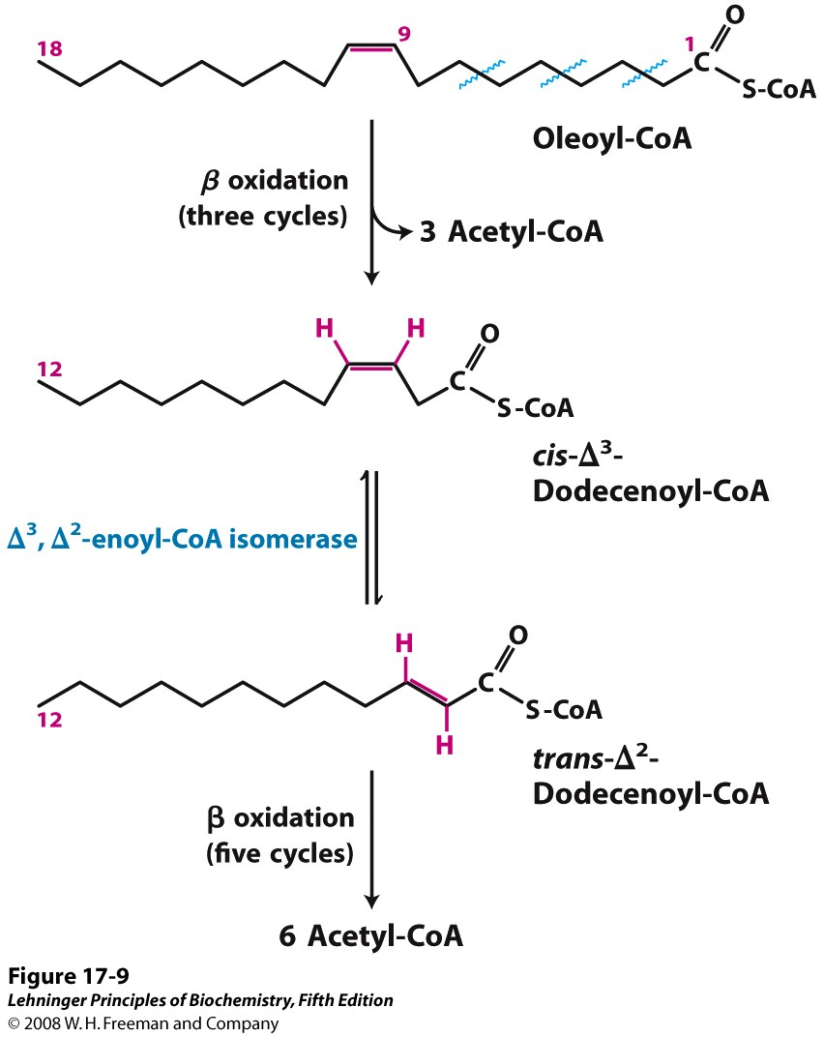

Slide 26
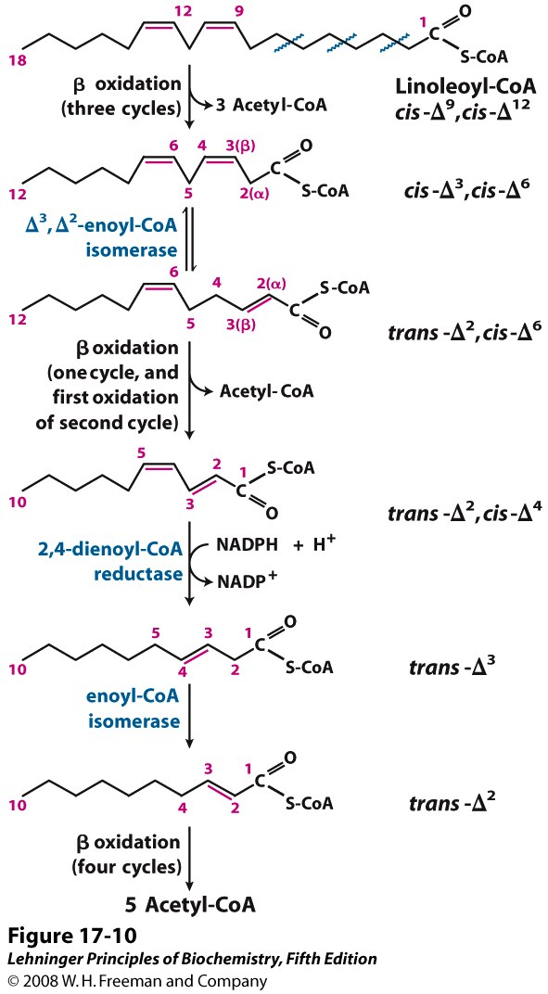

Slide 27
Summary
Oxidation of FA occurs in mitochondria
Transfer of FAs in to mitochondria via carnitine shuttle
Oxidation of even chain FAs consist four basic steps
Oxidation of odd chain FAs need three other additional steps
UFA oxidation followed by change in cis form into trans from
Fatty acid oxidation is the major source of cell ATP

Slide 28
Thank You

